Slide 1


Monitoring environmental gene abundance of ARGs in situ with ROCker.
################################################################
################################################################
Roth Conrad, Kenji Gerhardt, Si-Yu Zhang, Brittany Suttner,
Luis M. Rodriguez-R, Luis H. Orellana, Amina Khan,
Hattie Webb, Amanda Williams-Newkirk,
Andrew Huang, Kostas Konstantinidis
Environmental Genomics Laboratory (GA Tech)
Culture Independent and Metagenomic Subtyping Group,
Enteric Diseases Laboratory Branch (CDC)
Oct. 2022
Notes:
[too many names? Additional names?]

Slide 2
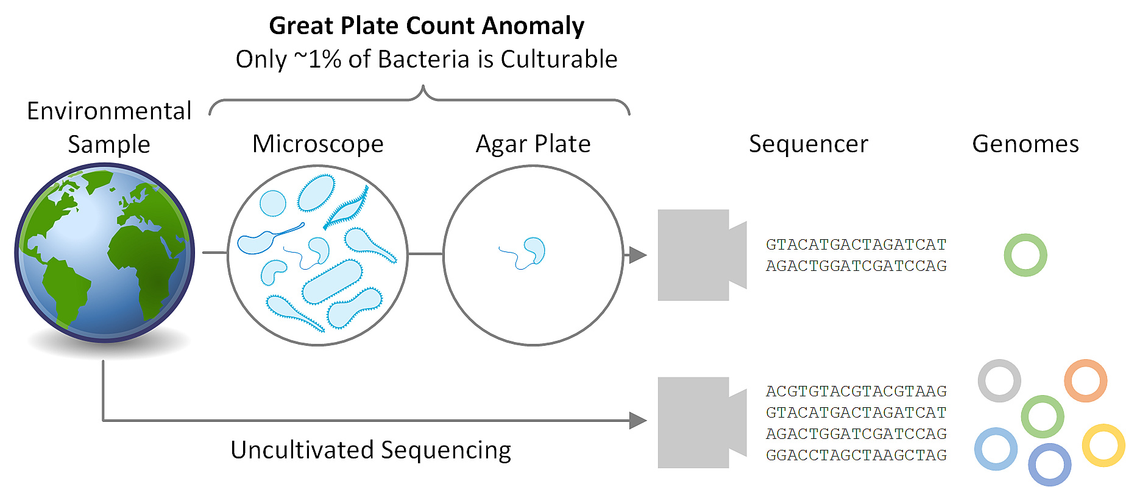
The goal is to utilize high-throughput metagenomics data to monitor and quantify the abundance of specific gene functions.
#########################################################################################################
isolate
metagenome
Isolation requires a lot of effort and access to isolates dwindling.
A gene of interest may be present in the community or even within a species population but not captured in the genome of a particular isolate (i.e., accessory or auxiliary genes).
Accessory genes can be transferred (i.e., conjugation, transformation, and transduction).
We want to monitor for potential genes of interest across the entire community.
Notes:
Each color represents a species population and then the little triangles here can represent a gene of interest. An accessory gene. A mutation or transfer that occurs.

Slide 3
Genes can pass and evolve from commensal or transient genomes to pathogens.
#########################################################################################################
isolate
metagenome
Colors represent distinct species populations.
Wedges represent non-core genes of interest.
Wedges can evolve and move over time.
Notes:
Each color represents a species population and then the little triangles here can represent a gene of interest. An accessory gene. A mutation or transfer that occurs.

Slide 4
Short sequence reads are aligned to reference sequences to be classified.
#########################################################################################################
isolate
metagenome
Colors represent distinct species populations
Wedges represent non-core genes of interest
Wedges can evolve and move over time.
Genomes are fragmented and sequenced.
Short reads are mapped to references based on alignment scores.
In our case we’re using BLASTx and the bitscore.
Notes:
Each color represents a species population and then the little triangles here can represent a gene of interest. An accessory gene. A mutation or transfer that occurs.

Slide 5
Example scenarios of short sequence reads mapped to a gene of interest.
#########################################################################################################
sequence position
Here’s our wedge gene sequence
MMQHTSVWYRRSVSPFVLVASVAVFLTATANLTFFDKISQTYPIADNLGFVLTIAVVLFGAMLLITTLLS
Higher bitscores equate to better sequence alignments.
A threshold is chosen to classify a short read sequence as positive or negative match to the target gene sequence.
Static alignment score filter threshold.
bitscore
sequence position
Notes:
Each color represents a species population and then the little triangles here can represent a gene of interest. An accessory gene. A mutation or transfer that occurs.

Slide 6
If only life were this easy …
#########################################################################################################
sequence position
Here’s our wedge gene sequence
MMQHTSVWYRRSVSPFVLVASVAVFLTATANLTFFDKISQTYPIADNLGFVLTIAVVLFGAMLLITTLLS
In the simple and clear case, a static alignment score filter works.
Sufficient sequence distance between gene/function.
True positive classification is made.
Off target reads are discarded.
Good relative abundance estimate achieved.
Still an issue of how to choose the filter threshold.
Static alignment score filter threshold.
bitscore
sequence position
Notes:
Each color represents a species population and then the little triangles here can represent a gene of interest. An accessory gene. A mutation or transfer that occurs.

Slide 7
Danger, Will Robinson: look out for false positives.
#########################################################################################################
sequence position
Here’s our wedge gene sequence
MMQHTSVWYRRSVSPFVLVASVAVFLTATANLTFFDKISQTYPIADNLGFVLTIAVVLFGAMLLITTLLS
Alternate scenario
Target gene/function is absent but similar sequence is present.
Results in false positive classification for the target gene/function.
An abundance estimate is still obtained.
Static alignment score filter threshold.
bitscore
sequence position
Notes:
Each color represents a species population and then the little triangles here can represent a gene of interest. An accessory gene. A mutation or transfer that occurs.

Slide 8
Ideally, we want an adaptive threshold filter that fits the data.
#########################################################################################################
sequence position
Here’s our wedge gene sequence
MMQHTSVWYRRSVSPFVLVASVAVFLTATANLTFFDKISQTYPIADNLGFVLTIAVVLFGAMLLITTLLS
Sequence conservation varies across the length of a gene (i.e. conserved motifs vs unique mutations)
Static sequence alignment filters miss this variation.
Implement variable, sliding-window, bitscore threshold that can be more or less stringent as needed.
Fewer false positives
Fewer false negatives
Adaptive
threshold
filter
Static
threshold
filter
bitscore
sequence position
Notes:
Each color represents a species population and then the little triangles here can represent a gene of interest. An accessory gene. A mutation or transfer that occurs.

Slide 9
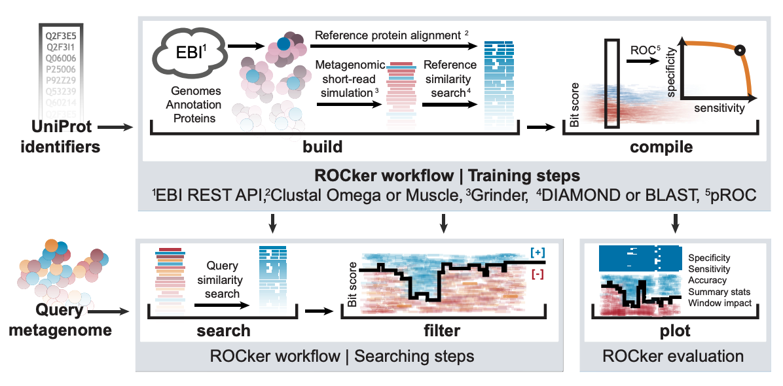
Algorithmically determine the optimal adaptive threshold.
#########################################################################################################
Collect gene and genome sequences for target functions, and non-target similar sequences.
Use ROC curve to determine optimal threshold value across a sliding window.
Apply variable bitscore filter to real world datasets.
Developed, validated, and published for nirK and nosZ by colleagues in 2016.
Fig. 1: Orellana LH, Rodriguez-R LM, Konstantinidis KT. Nucleic acids research. 2017.
ROC curve: Receiver operating characteristic curve measures the diagnostic ability of a binary classifier system as its discrimination threshold is varied.
Notes:
Figure 1. ROCker workflow for generating simulated shotgun data sets and calculating position-specific and most-discriminant bitscores. (Upper panel) ROCker can be used to perform five independent tasks: (i) Build: Using a user-provided list of unique UniProt protein identifiers for a target protein of interest, ROCker downloads the reference sequences, their corresponding whole genomes and annotation from the European Bioinformatics Institute (EBI) using the REST API. The protein references are aligned and the whole genomes used for the simulation of short-read Illumina metagenomes and then are searched against the protein reference sequences. The outputs of these searches are then provided to the (ii) Compile function, where the results are translated to alignment windows where it identifies the most discriminant bitscore that minimizes false positives but maximizes true positive matches. These results are compiled in ‘ROCker profiles’ that essentially represent an adaptable and reusable filter for the output of similarity searches increasing the accuracy of finding a true match compared to the most common practice of using fixed e-value thresholds. (Lower panel) (iii) Search: Short-read metagenomes are used as query in a similarity search using the target protein sequences as database (iv) Filter: This tool filters similarity searches using pre-calculated ROCker profiles. Finally, (v) Plot generates a graphical representation of the ROCker profiles along with the reference sequence alignments and summary statistics (see Supplementary Figure S1 for an extract of this feature).
Orellana LH, Rodriguez-R LM, Konstantinidis KT. ROCker: accurate detection and quantification of target genes in short-read metagenomic data sets by modeling sliding-window bitscores. Nucleic acids research. 2017 Feb 17;45(3):e14-.

Slide 10
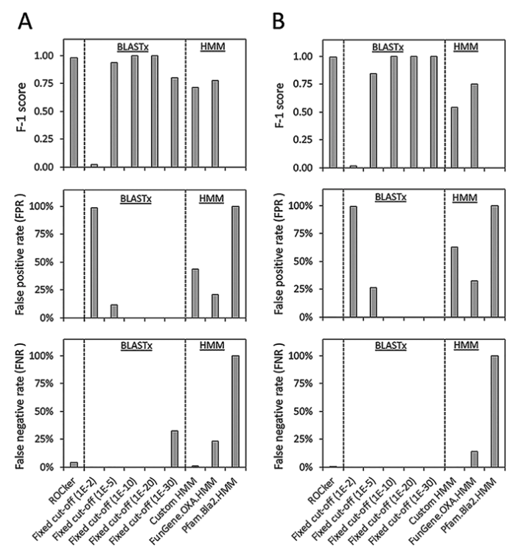
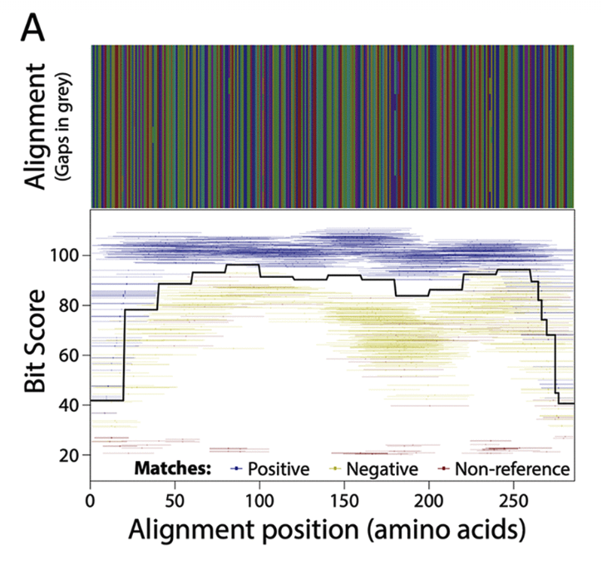
Validated and published ROCker models for ß-Lactamase genes improve detection.
#########################################################################################################
Fig. 1 & Fig. 4: Zhang SY, et. al. mSystems. 2022.
Notes:
FIG 4 Performance of the class D BL ROCker model on 150-bp (A) and 250-bp (B) mock data sets compared to alternative methods. The methods and parameters were as described for Fig. 3, and the same statistics are shown.
Zhang SY, Suttner B, Rodriguez-R LM, Orellana LH, Conrad RE, Liu F, Rowell JL, Webb HE, Williams-Newkirk AJ, Huang A, Konstantinidis KT. ROCker Models for Reliable Detection and Typing of Short-Read Sequences Carrying β-Lactamase Genes. Msystems. 2022 Jun 28;7(3):e01281-21.

Slide 11


The state of the project when we were brought on board.
#########################################################################################################
Tons of upfront, manual work. No streamlined/standardized workflow.
The software for ROCker was slow, not well documented, and written in an obscure language.
Third party software and databases were updated, and ROCker was broken.
The original (OG) ROCker made one boring plot and not helpful intermediate files.
We wanted to build new ROCker models for ARGs: mcr, mph, erm, and lnu.

Slide 12


Our plan of attack. Divide and conquer.
#########################################################################################################
Introducing ROCker I/O: ROCkin / ROCkout
ROCkin
Standardize and streamline workflow.
Write custom code to reduce manual work required by the user.
Implement unsupervised clustering algorithm to suggest a reproducible model starting point for positive vs negative input sequences.
ROCkout
Fix/Update OG ROCker software with improved maintainability.
Rewrite file structure for more useful intermediate files and clearer user warnings.
Upgrade flat images to a cool interactive plotting interface.
Roth Conrad
Kenji Gerhardt

Slide 13
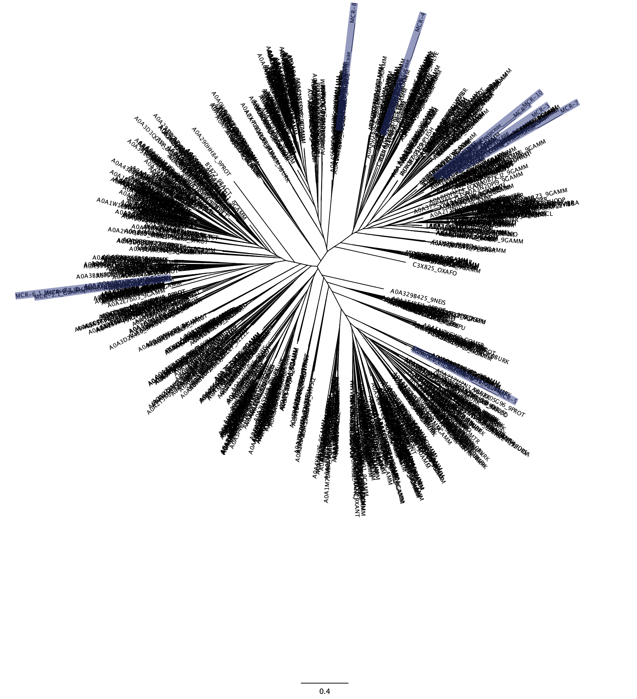


Reduce manual bioinformatics time so users can focus on the decision-making research.
#########################################################################################################
Phylogeny
(still very manual)
Original Proteins
Retrieve fasta files for
UniRef Matches
Filter results
BLAST against online UniRef90
Reduce complexity (90% AA Clusters)
Multiple sequence
alignment
Unsupervised clustering, taxonomic classification, functional annotation.

Slide 14
Now we are ready to do this modelling part.
#########################################################################################################
sequence position
Here’s our wedge gene sequence
MMQHTSVWYRRSVSPFVLVASVAVFLTATANLTFFDKISQTYPIADNLGFVLTIAVVLFGAMLLITTLLS
Sequence conservation varies across the length of a gene (i.e. conserved motifs vs unique mutations)
Static sequence alignment filters miss this variation.
Implement variable, sliding-window, bitscore threshold that can be more or less stringent as needed.
Fewer false positives
Fewer false negatives
Adaptive
threshold
filter
Static
threshold
filter
bitscore
sequence position
Notes:
Each color represents a species population and then the little triangles here can represent a gene of interest. An accessory gene. A mutation or transfer that occurs.

Slide 15
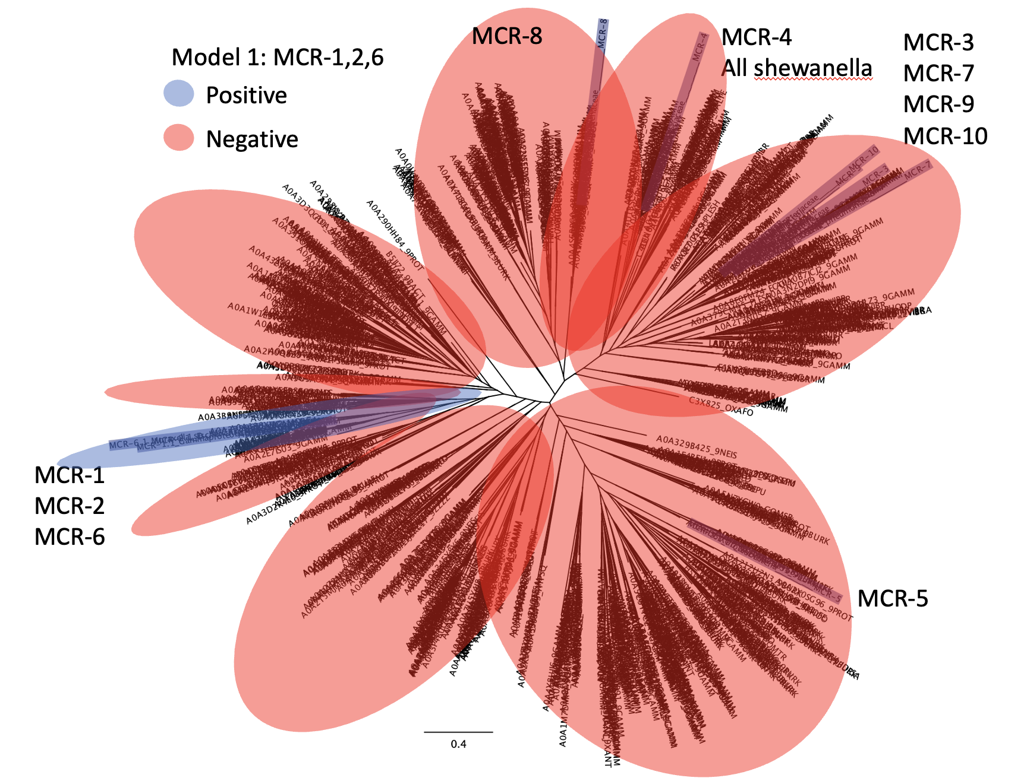
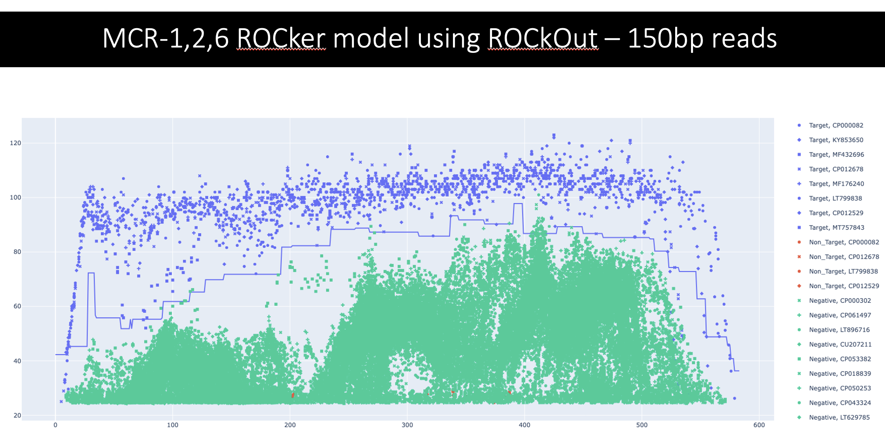
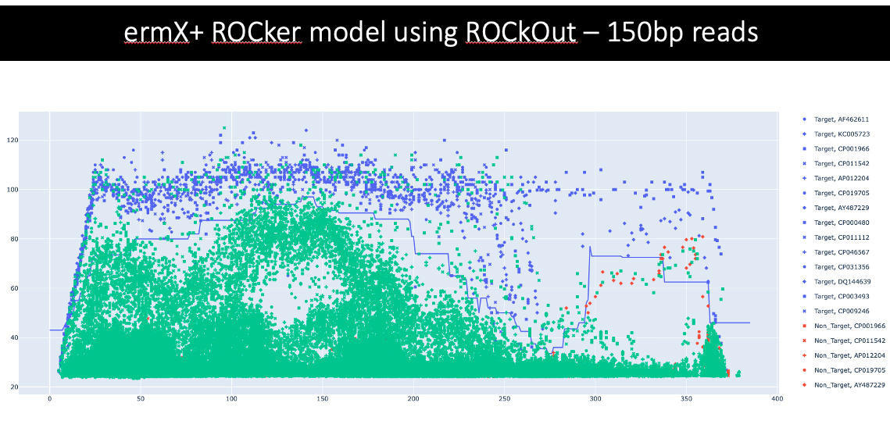
We’ve produced first drafts of four ARG models.
#########################################################################################################

Slide 16
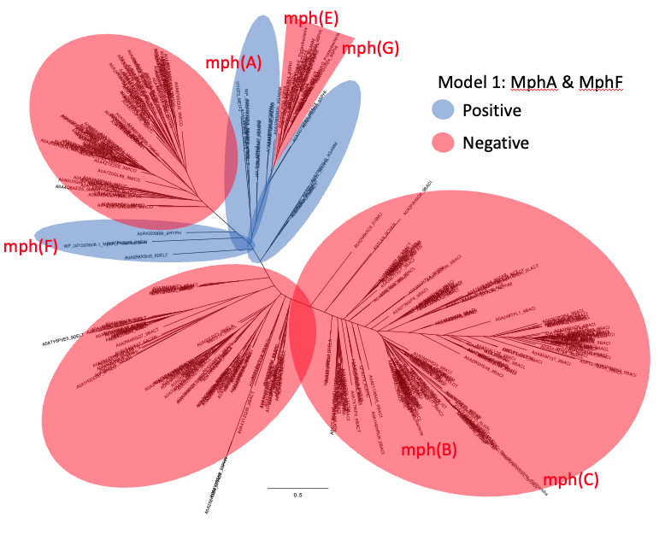
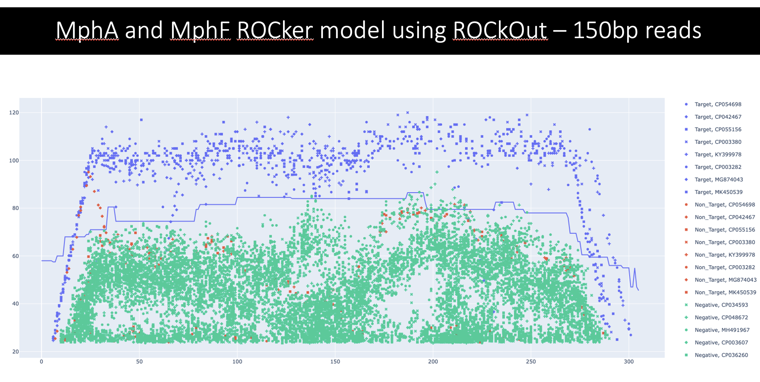
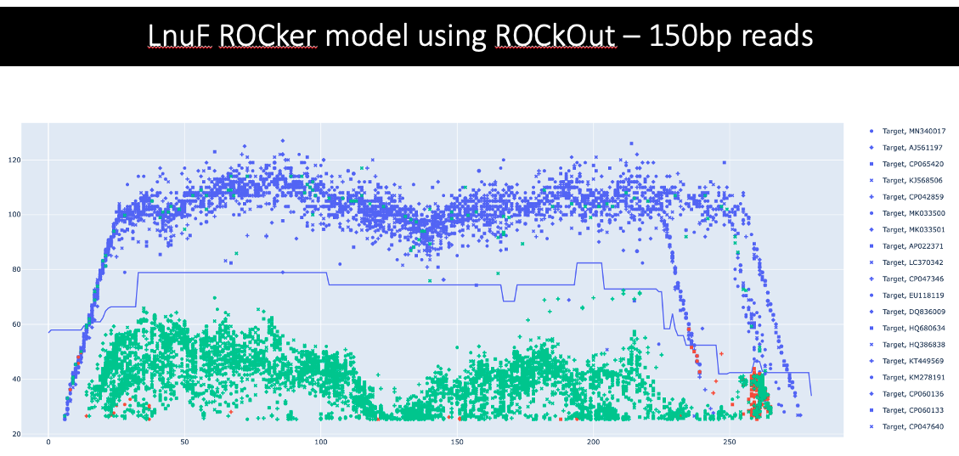
We’ve produced first drafts of four ARG models.
#########################################################################################################

Slide 17
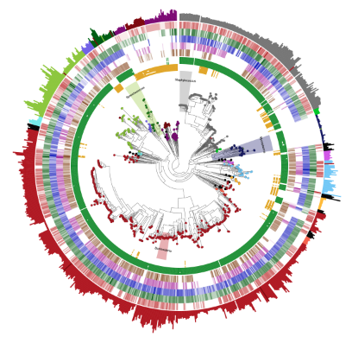
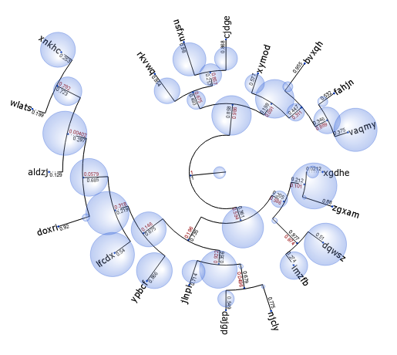
Future Directions:
#########################################################################################################
Phylogenetic read placement for increased phylogenetic classification
Meta-data on top of tree output

Slide 18
Test the models with synthetic and real data.
#########################################################################################################
isolate
metagenome
Colors represent distinct species populations
Wedges represent non-core genes of interest
Wedges can evolve and move over time.
Genomes are fragmented and sequenced.
Short reads are mapped to references based on alignment scores.
In our case we’re using BLASTx and the bitscore.
Notes:
Each color represents a species population and then the little triangles here can represent a gene of interest. An accessory gene. A mutation or transfer that occurs.

